Slide 1
Solution Quiz 1
Distributed Computing
Date of Quiz: 15 March 2010

Slide 2
Answer Q1
Part a. Message format
Part b. Duplicate Messages
  A requestId, which is taken from an increasing sequence of integers by the sender can be used to track duplicate messages.
messageType
int (0=Request, 1= Reply)
requestId
int
objectReference
RemoteObjectRef
methodId
int or Method
arguments
array of bytes

Slide 3
Answer Q1
Part c. Communication omission failure are concerned with the handling of dropped messages. Since, RR protocol uses UDP as transport therefore it does not take care of transmission failures. In case, if the RRP protocol is implemented over TCP then the ACK mechanism of TCP takes care of the communication failure.

Slide 4
Answer Q2
Person | 8 bit version number |  |  | Ho
4 | java.lang.String Name | java.lang.String City | int year | Java.lang.String Gender
3 Ali | 6 Lahore | 1980 | 4 Male | H1

Slide 5
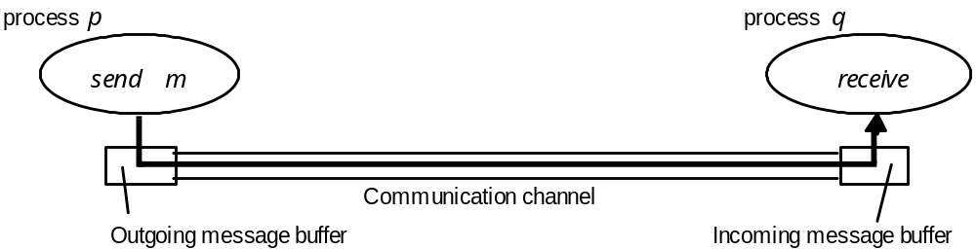
Answer Q3
Send-omission failure: loss of msg b/w the sending process & outgoing msg buffer. A process completes a send but the message is not put in its outgoing message buffer.
Receive-omission failure: loss of msg b/w the incoming msg buffer & the receiving process. A message is put in a process’s incoming message buffer, but that process does not receive it.

